Slide 1
2022
CANTON JUNETEENTH CELEBRATION
June 18, 2022
JOIN THE CELEBRATION!!!

Slide 2
WHAT IS
JUNETEENTH?

Slide 3
Juneteenth is the oldest known celebration commemorating the ending of slavery in the United States. Dating back to 1865, it was on June 19th that the Union soldiers, led by Major General Gordon Granger, landed at Galveston, Texas with news that the war had ended and that the enslaved were now free. Note that this was two and a half years after President Lincoln’s Emancipation Proclamation was signed abolishing slavery in the United States.

Slide 4
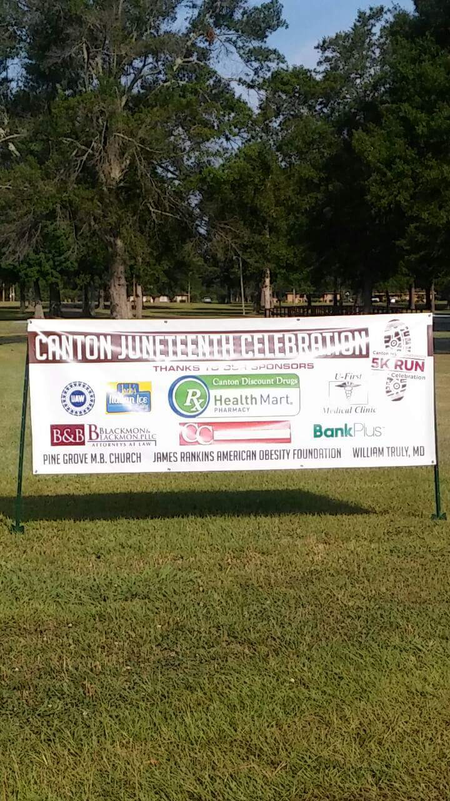

Slide 5
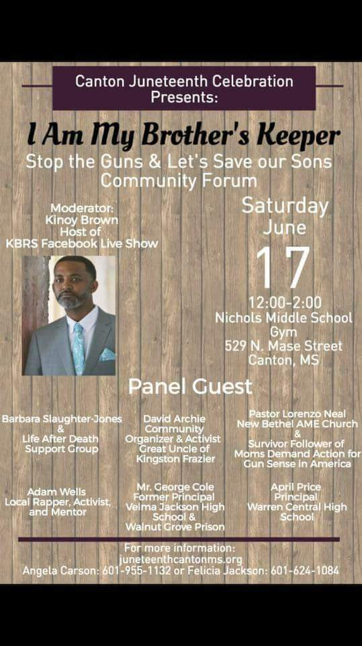

Slide 6
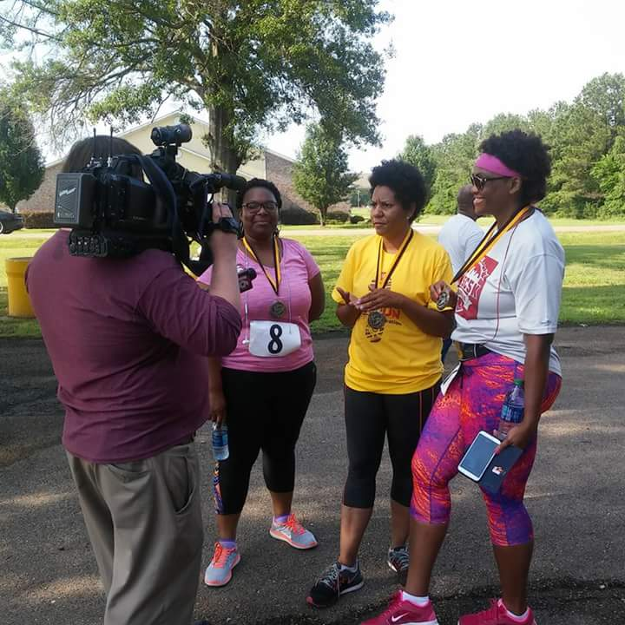

Slide 7
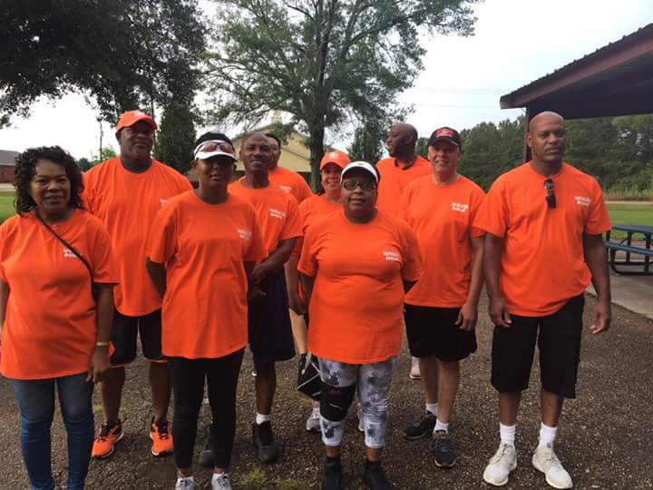

Slide 8
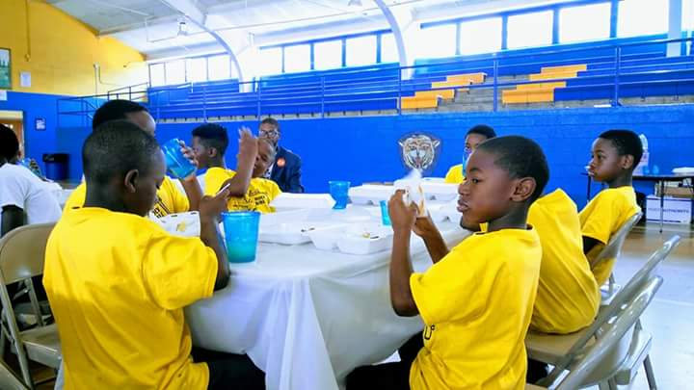

Slide 9
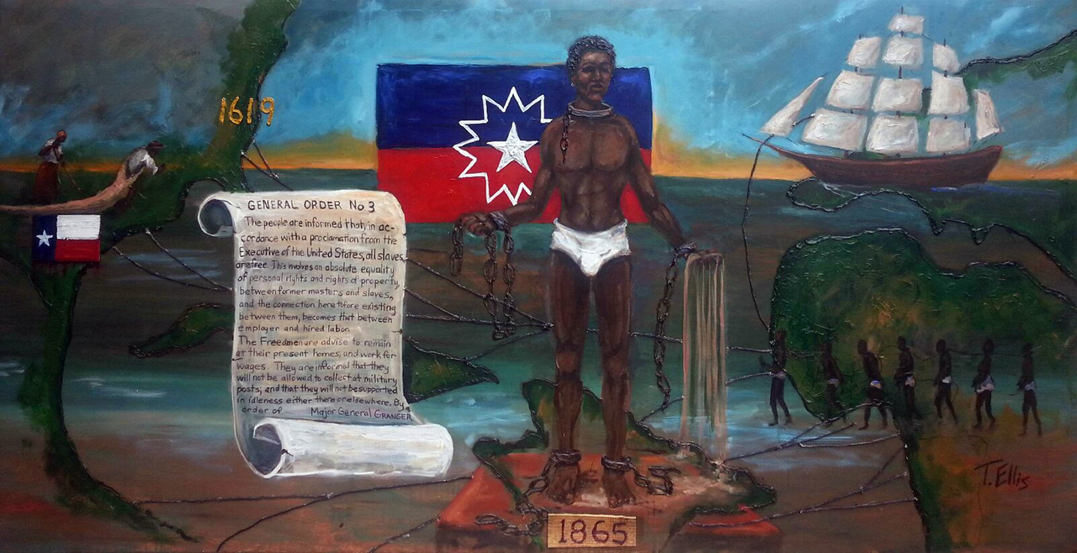

Slide 10
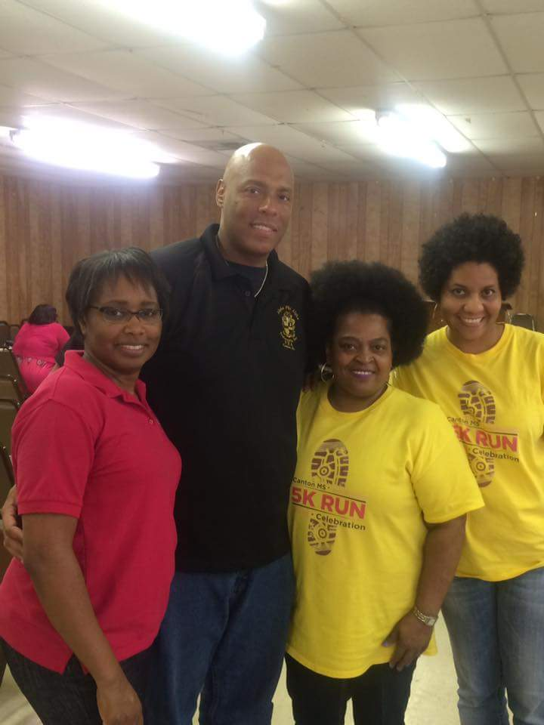

Slide 11
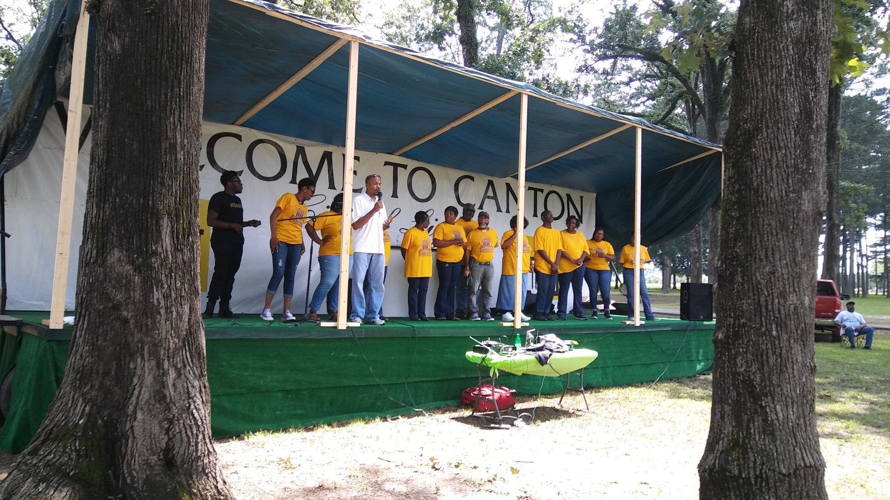

Slide 12
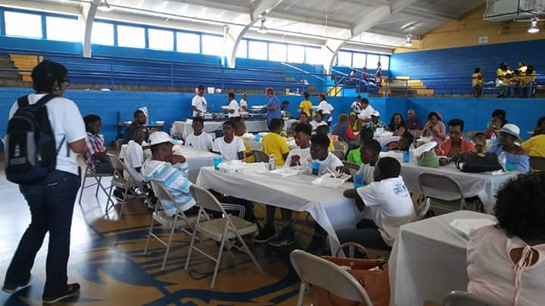

Slide 13
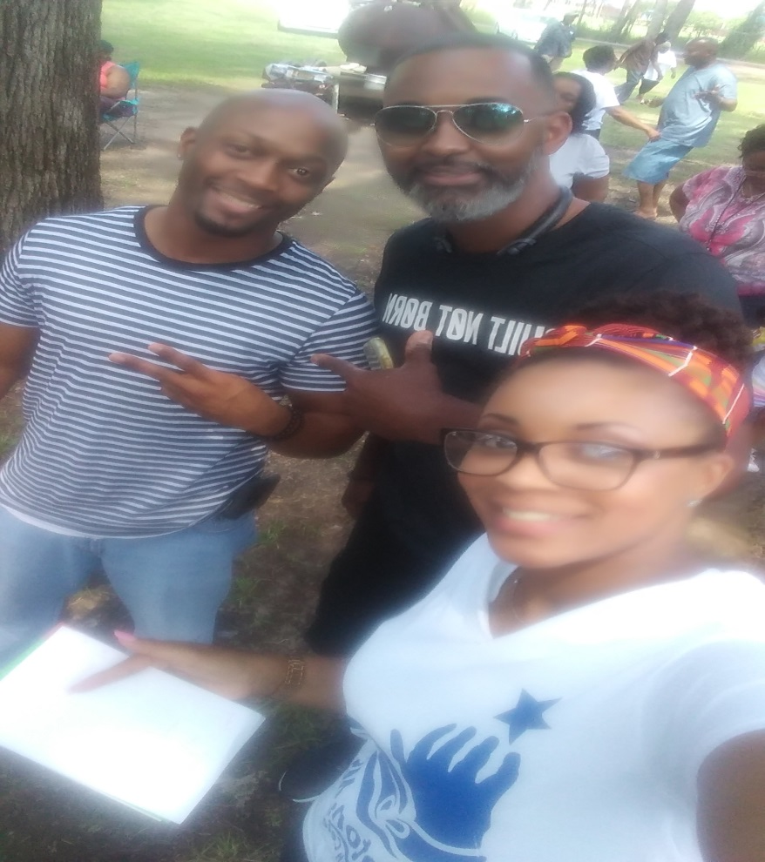

Slide 14
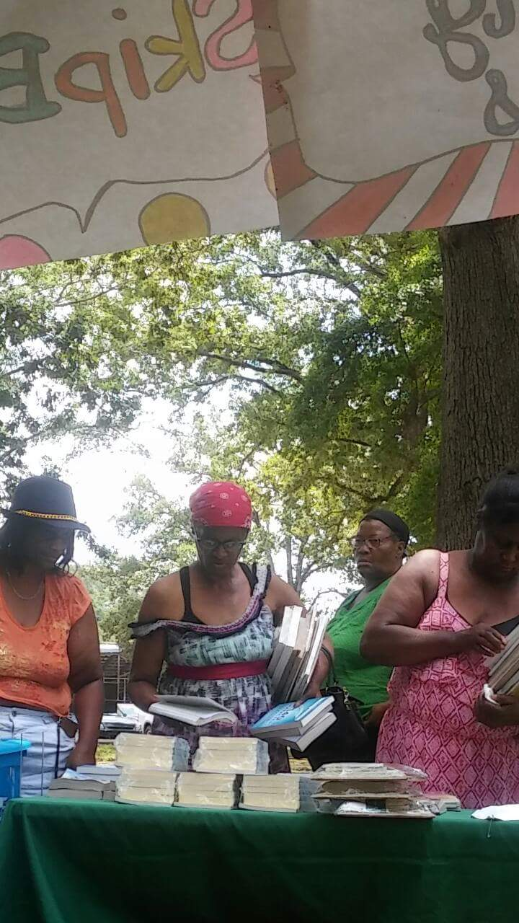

Slide 15
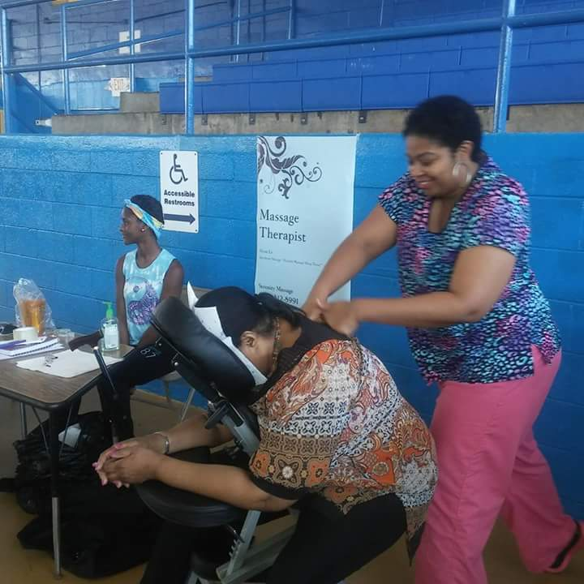

Slide 16
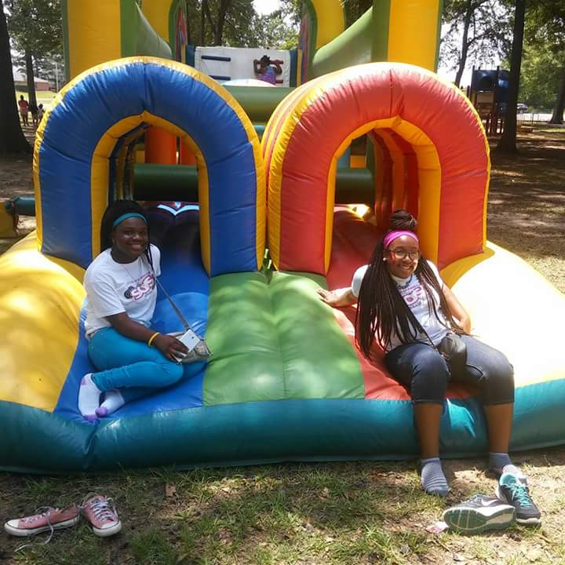
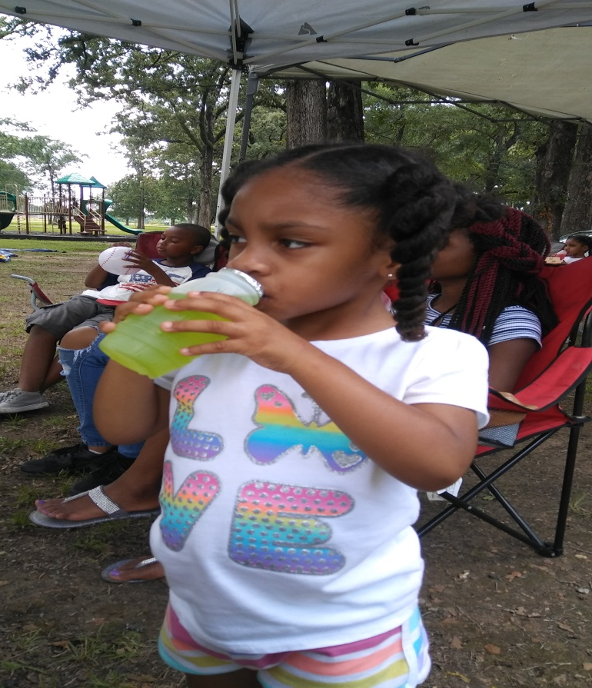

Slide 17
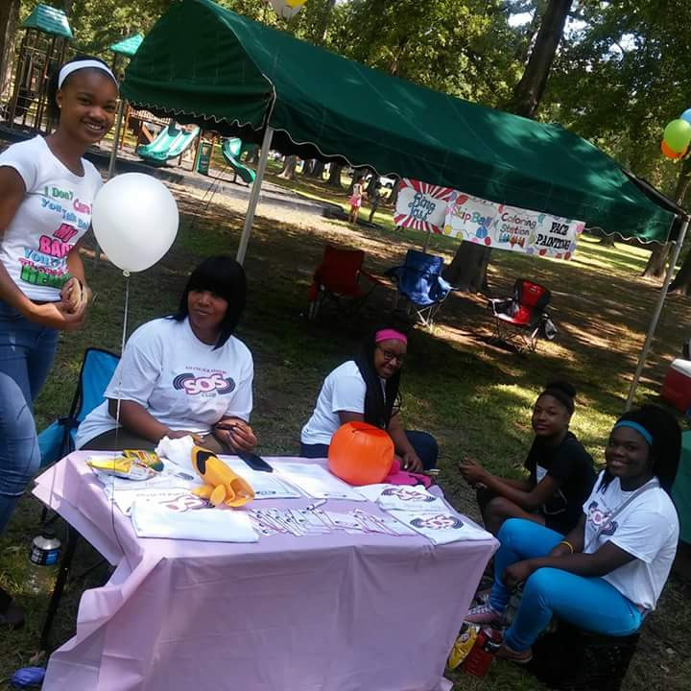

Slide 18
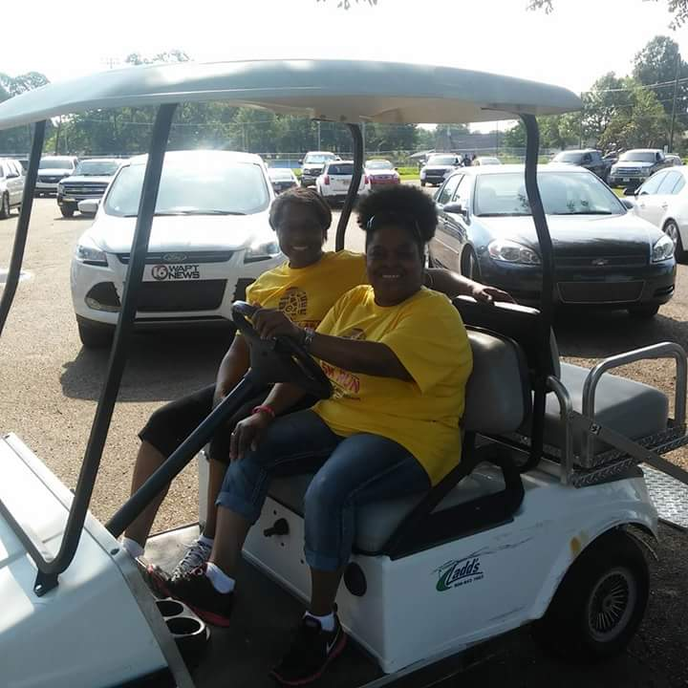

Slide 19
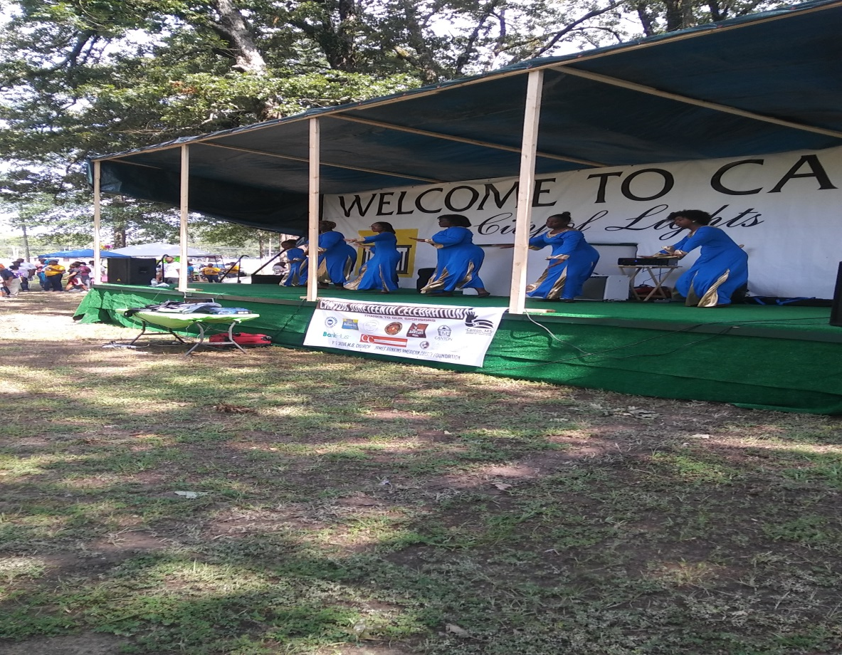

Slide 20
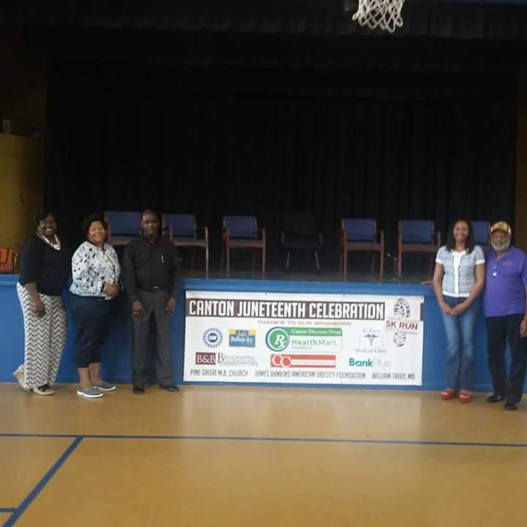
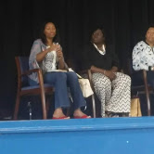
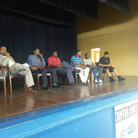
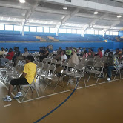

Slide 21
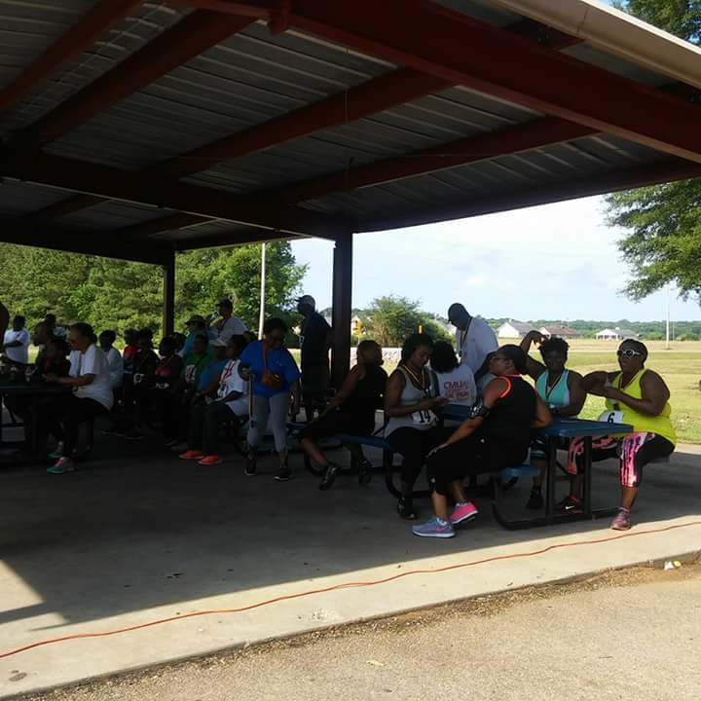

Slide 22
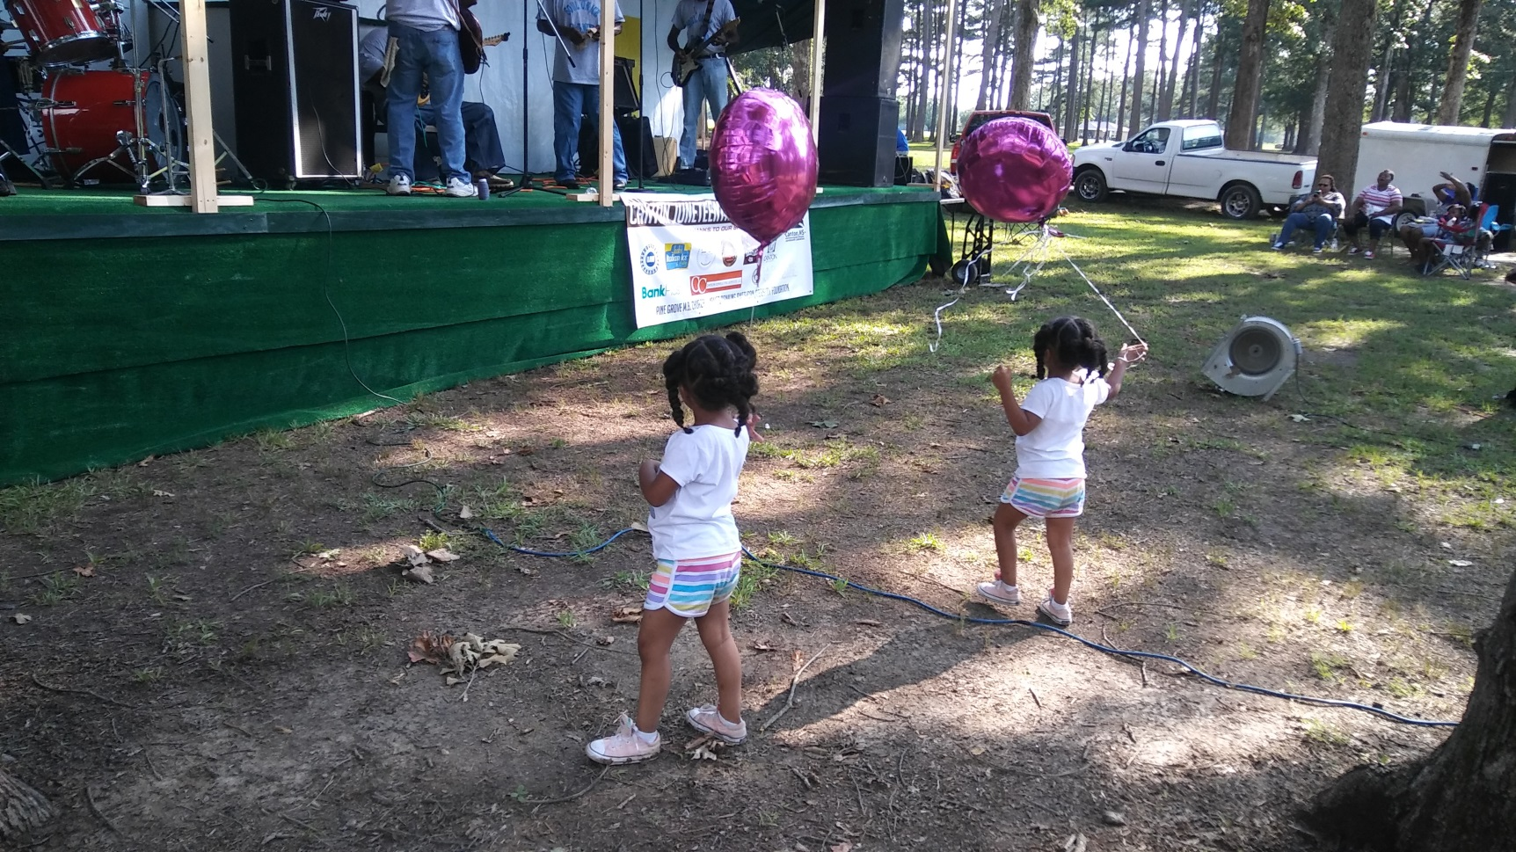

Slide 24
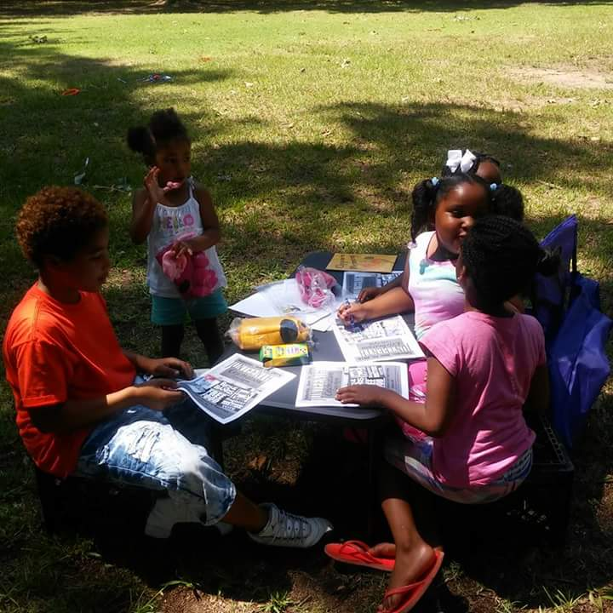

Slide 27
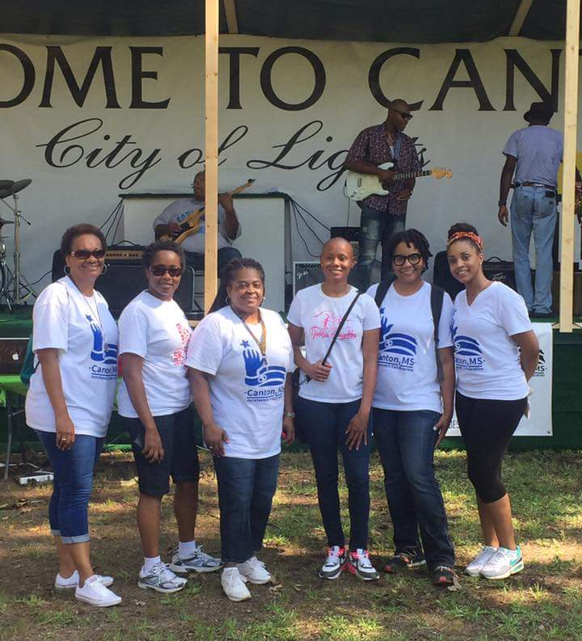
Canton, MS Juneteenth Celebration Committee

Slide 28
Canton Juneteenth Celebration
Angela Carson, Contact
cantonjuneteenth@gmail.com
601-955-1132

Slide 29
Produced by
Stacey J. Spencer,
Radio Personality
www.staceyjradioshow.com
Juneteenth History
© JUNETEENTH.com

